Slide 1
APOLOGETICS
IN ONE LESSON
almost
Ai1L.net
Introduction

Slide 2
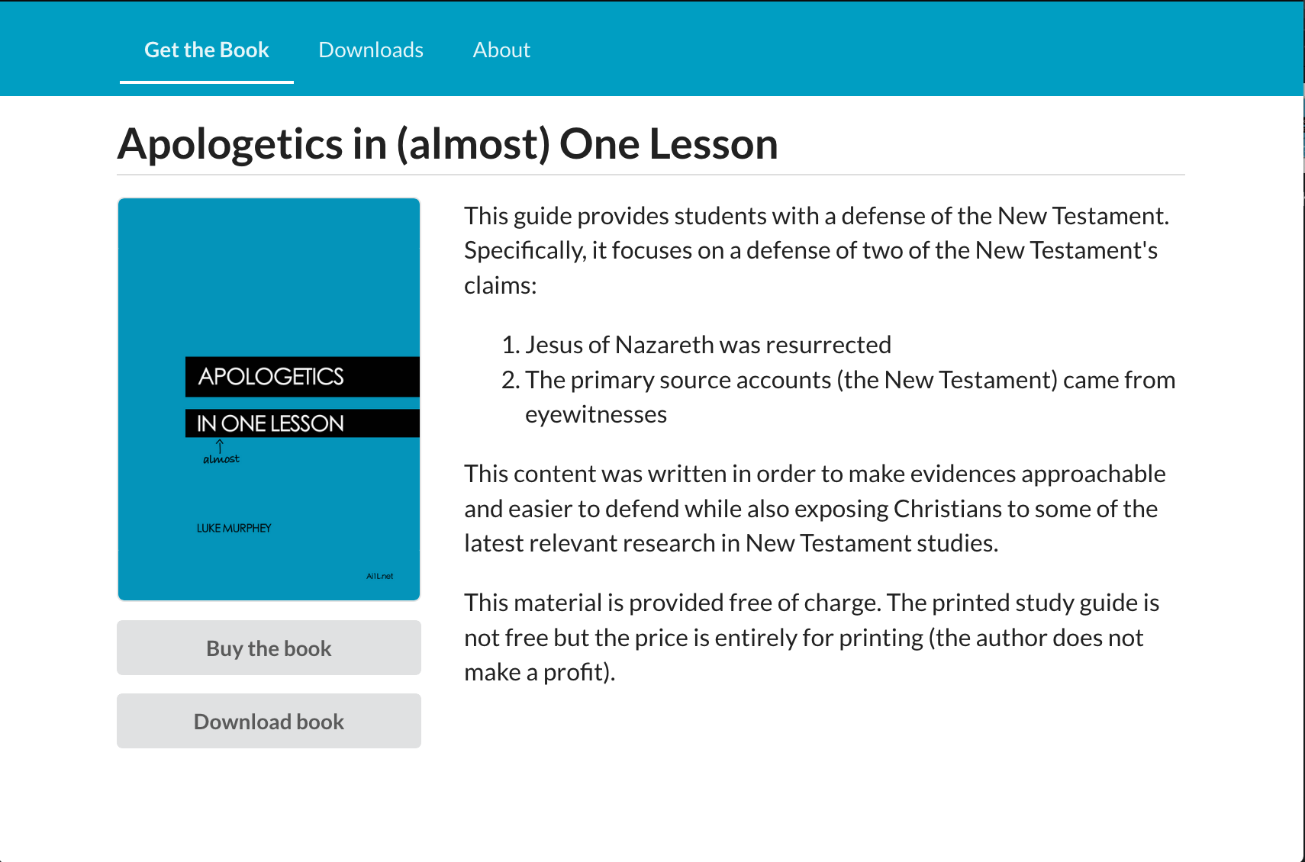
https://Ai1L.net

Slide 3
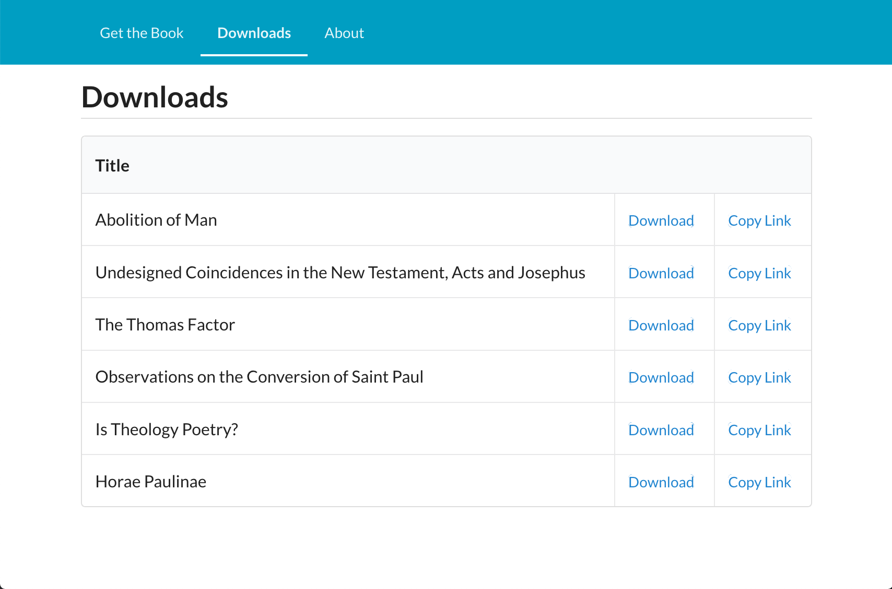

Slide 4
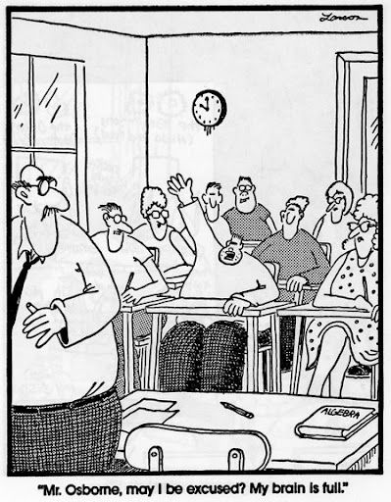

Slide 6
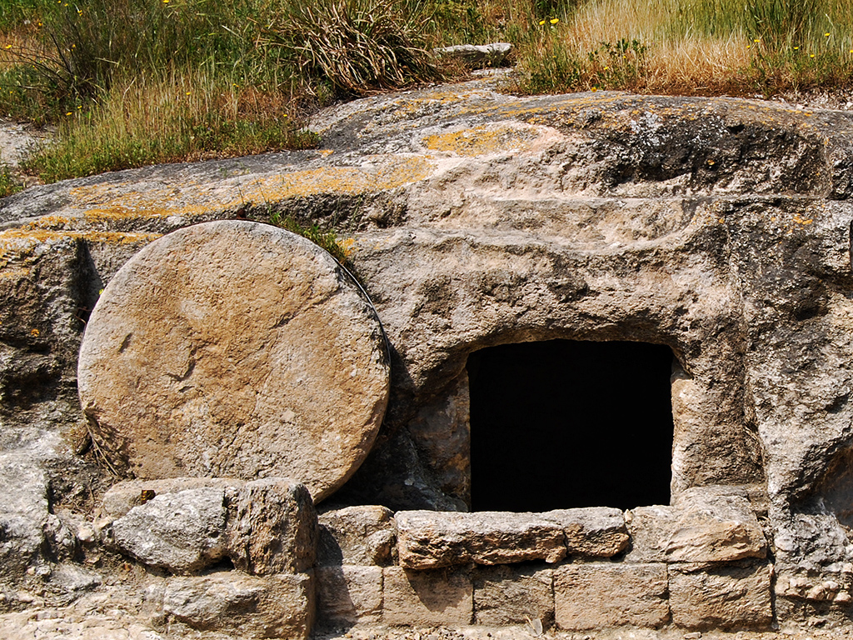
Tomb in Jezreel Valley
Photo by Ferrell Jenkins

Slide 7
Main facts
1
Jesus was resurrected
2
The New Testament came from eyewitnesses

Slide 8
Why focus on a defense of the resurrection?
1
Its Biblical
2
Its simpler & easier (since the Gospel is your strength)
3
Become more knowledgeable in the Gospel accounts

Slide 9
Subjective
“I want Christianity to be true”
Objective “I think Christianity is true”
Christianity meets our deepest needs:
Reason
Love
Forgiveness
Justice
Hope
Undesigned coincidences
Eyewitness sources
Christianity shouldn’t exist (if not for the resurrection)
Christianity can explain:
Reason
Love
Forgiveness
Justice
Hope
Ancient Jewish teaching practices
Prophecy: Isaiah 53

Slide 10
Key Takeaways
1
The approach we use is important; probably more than the arguments we use
2
Belief in Jesus is based upon one fact in history: Jesus’ resurrection
3
The resurrection can be supported by four facts: 1. Jesus was crucified
2. Jesus’ disciples believed he resurrected
3. Early skeptics (Paul, James) became believers
4. The tomb was empty

